Slide 1
Fiscal Policy and the Multiplier
Rajiv Sethi and the CORE Team

Slide 2
Overview
Components of Aggregate Demand
The Consumption Function
The Multiplier
Fiscal Policy
Reading: The Economy Unit 14 Introduction to 14.6

Slide 3
Components of Demand

Slide 4
Components of Aggregate Demand
Main components of demand for goods and services:
Consumption, C
Investment, I
Government purchases, G
Net Exports (Exports minus imports), X – M
Government expenditures have grown significantly as share of GDP
Investment (including residential) is volatile, also consumption of durables

Slide 5
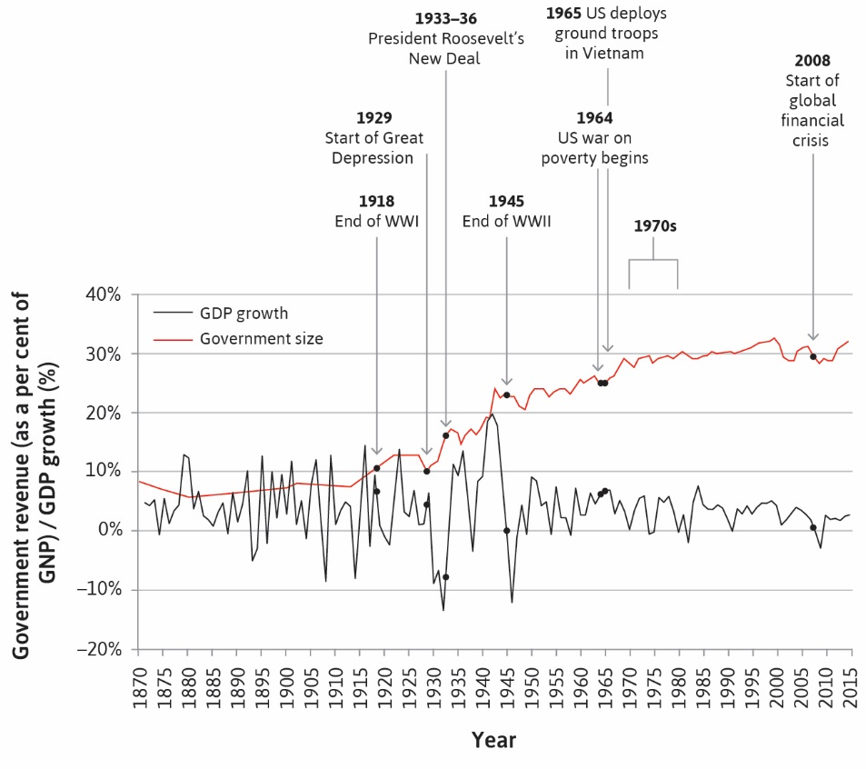

Slide 6
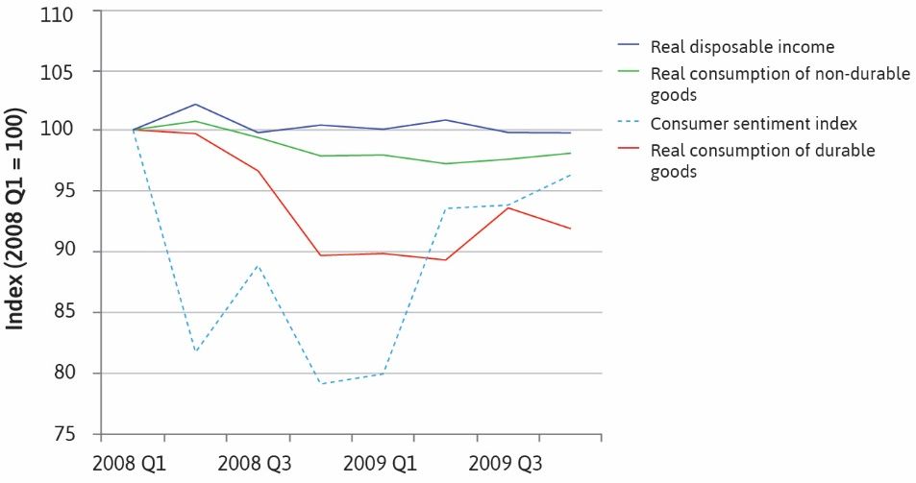

Slide 7
The Consumption Function

Slide 8
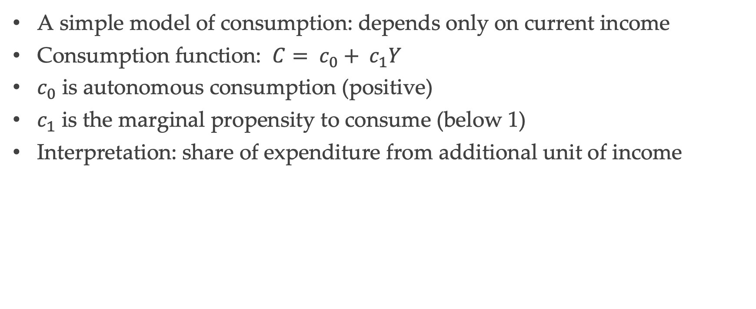
Consumption
A simple model of consumption: depends only on current income
Consumption function: $C= c_{0}+ c_{1}Y$
$c_{0}$ is autonomous consumption (positive)
$c_{1}$ is the marginal propensity to consume (below 1)
Interpretation: share of expenditure from additional unit of income

Slide 9
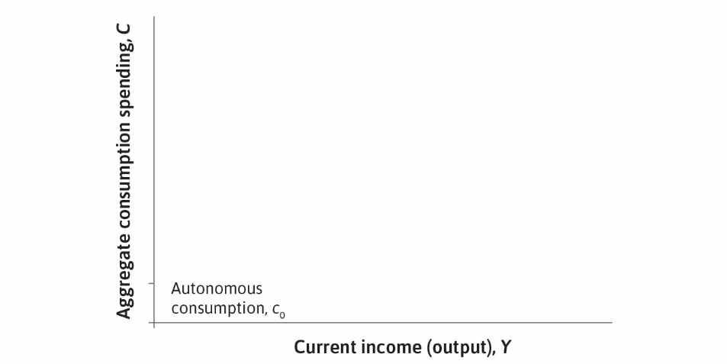

Slide 10
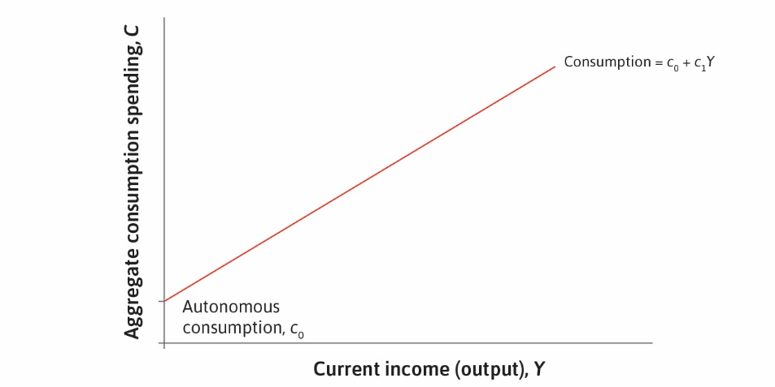

Slide 11
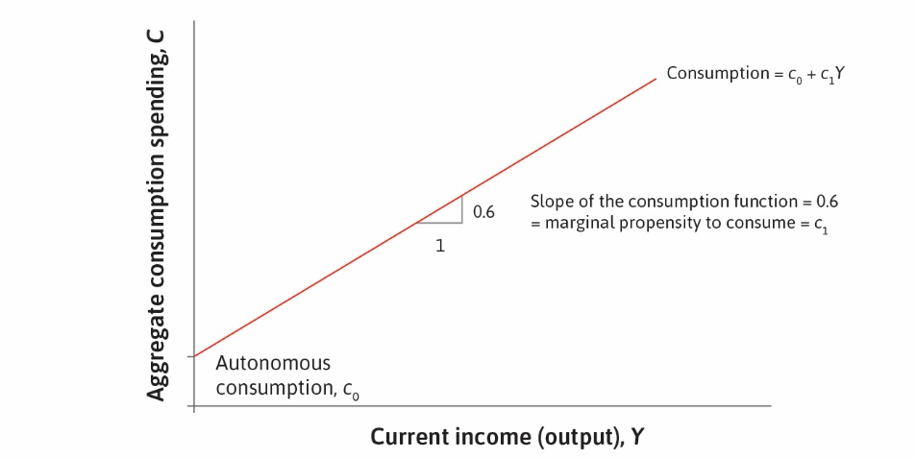

Slide 12
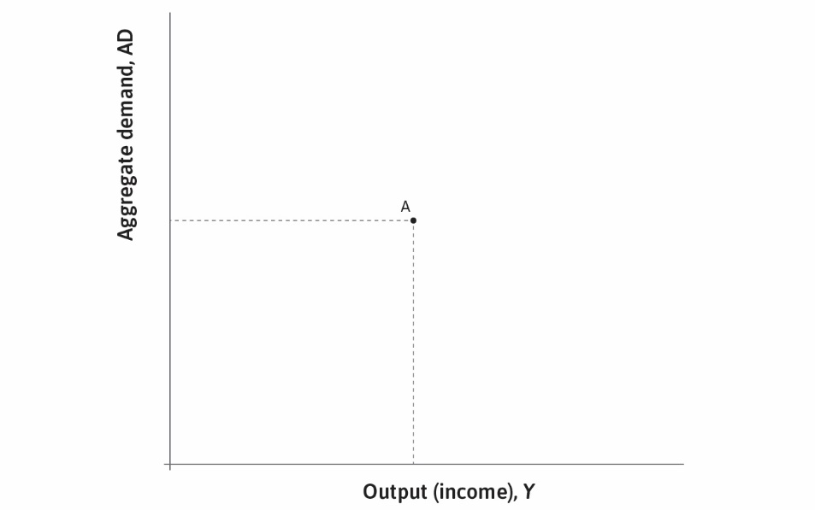

Slide 13
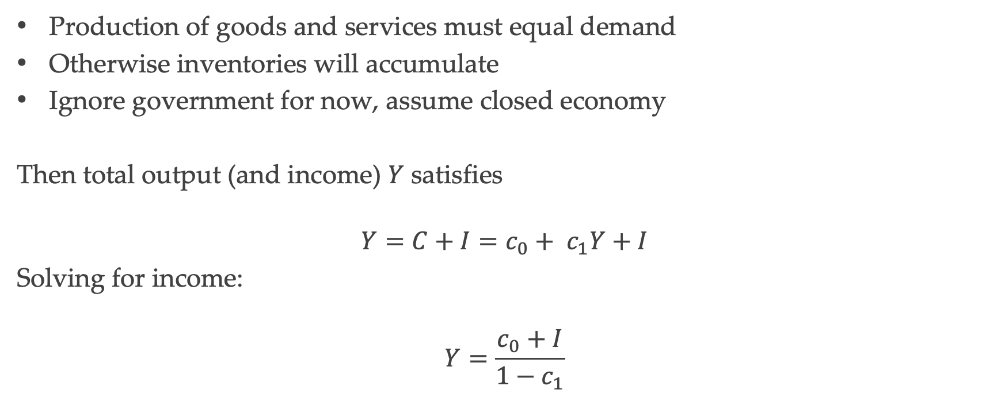
Equilibrium in the Goods Market
Production of goods and services must equal demand
Otherwise inventories will accumulate
Ignore government for now, assume closed economy
Then total output (and income) $Y$ satisfies
$$Y=C+I=c_{0}+ c_{1}Y+I$$
Solving for income:
$$Y=\frac{c_{0}+I}{1−c_{1}}$$

Slide 14
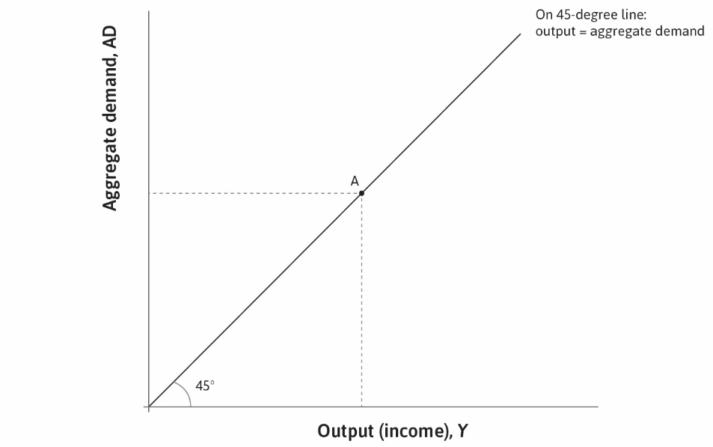

Slide 15
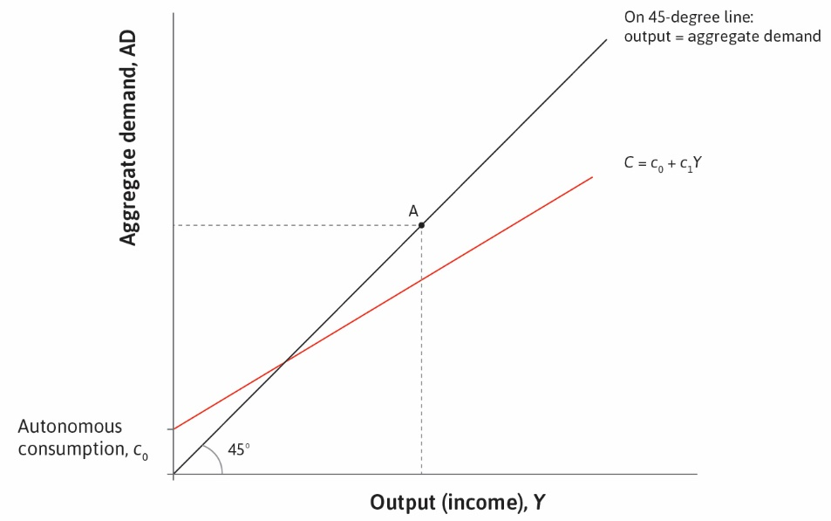

Slide 16
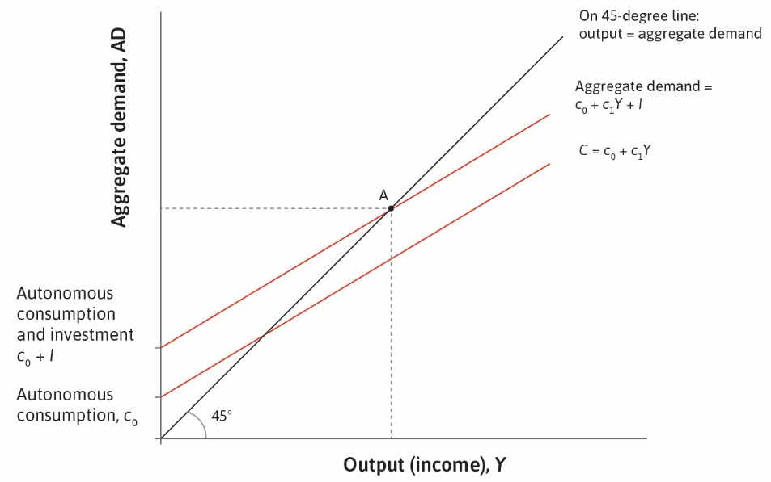

Slide 17
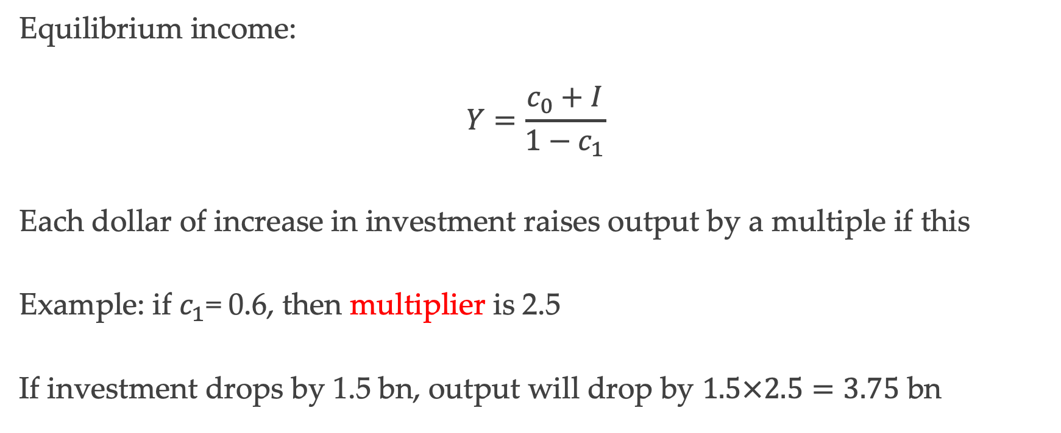
The Multiplier
Equilibrium income:
$$Y=\frac{c_{0}+I}{1−c_{1}}$$
Each dollar of increase in investment raises output by a multiple if this
Example: if $c_{1}$= 0.6, then multiplier is 2.5
If investment drops by 1.5 bn, output will drop by $1.5×2.5=3.75$ bn

Slide 18
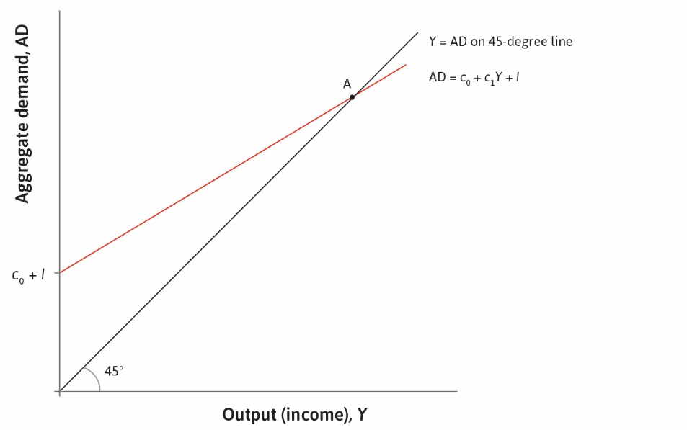

Slide 19
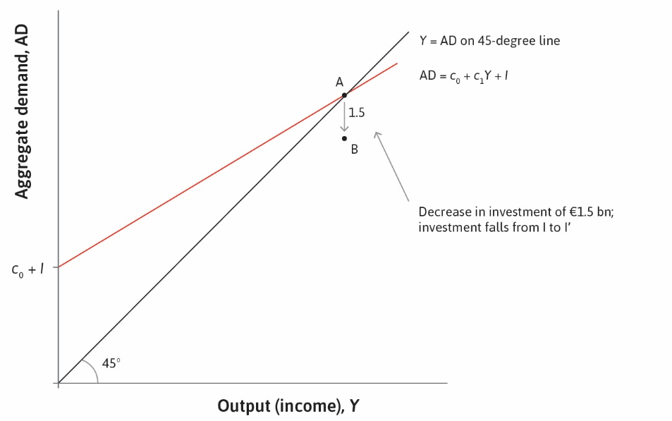

Slide 20
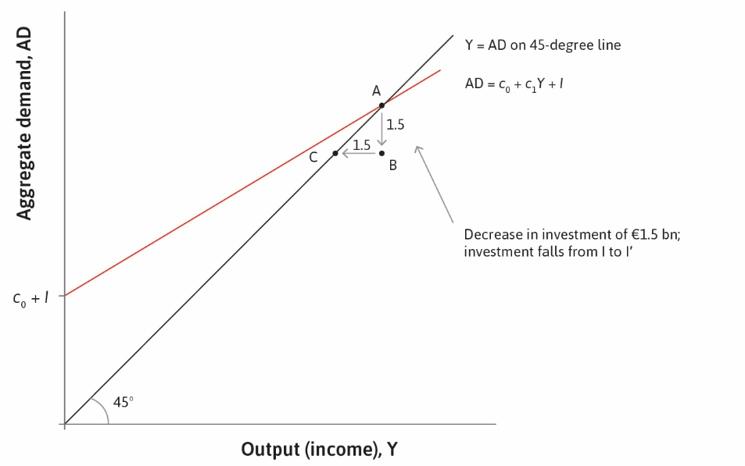

Slide 21
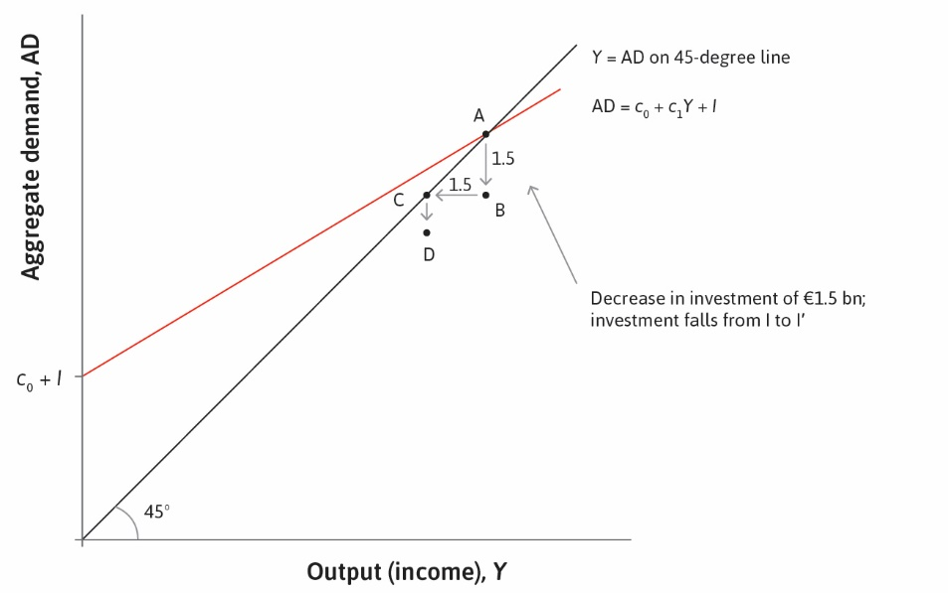

Slide 22


Slide 23


Slide 24
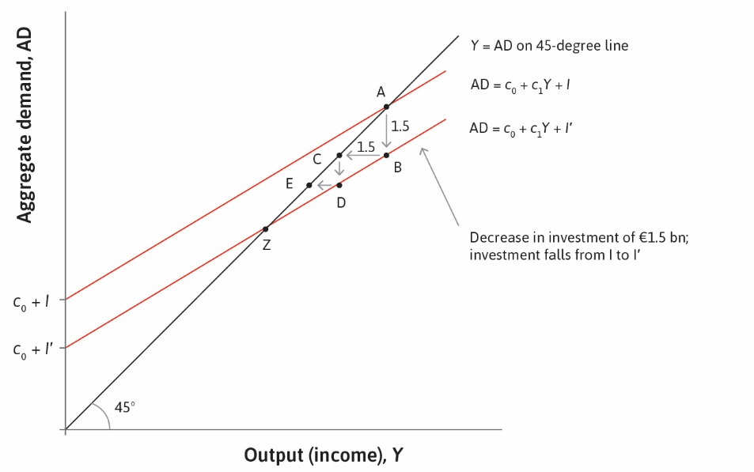

Slide 25
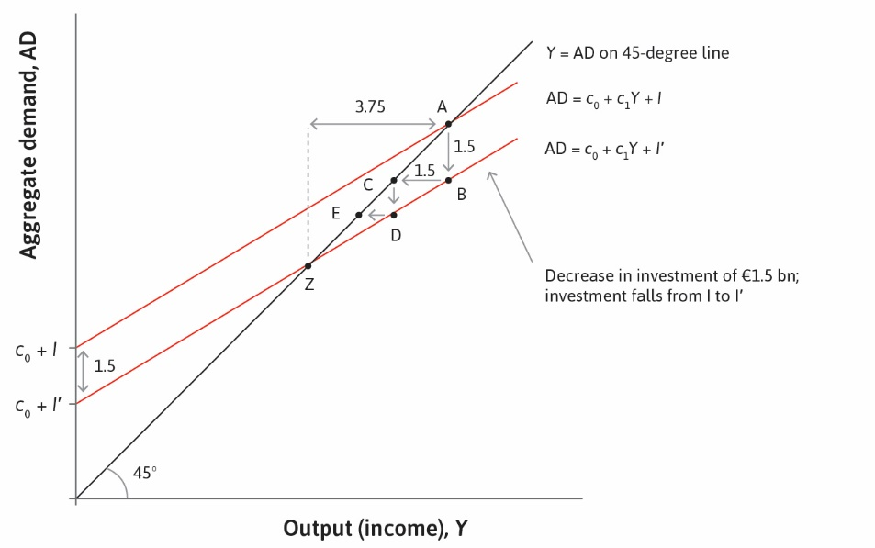

Slide 26
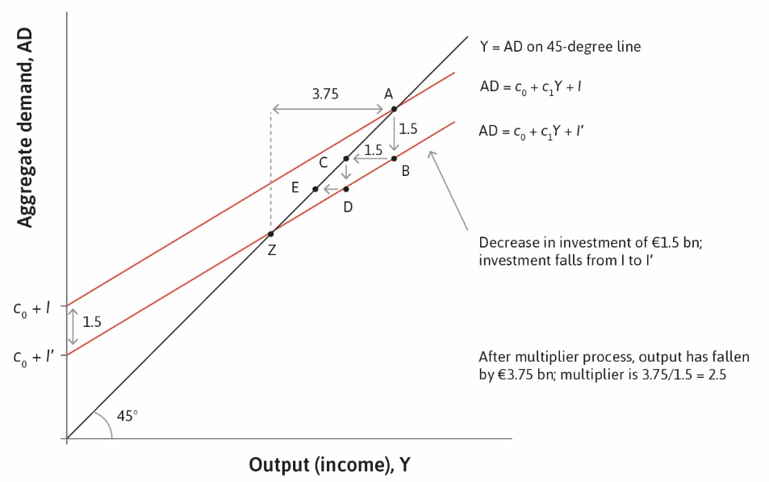

Slide 27
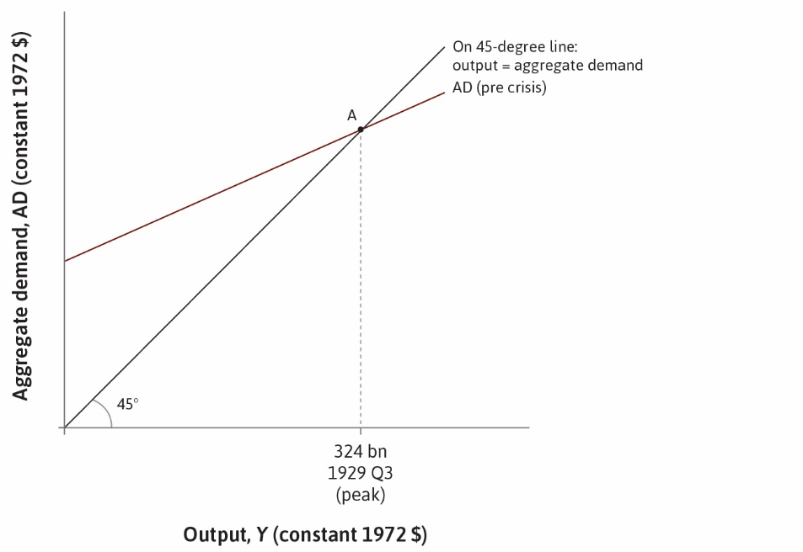

Slide 28
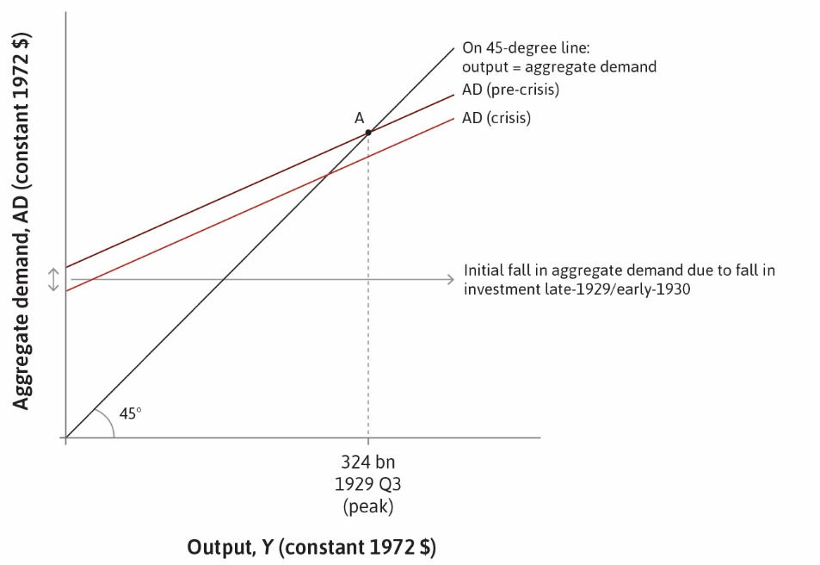

Slide 29


Slide 30
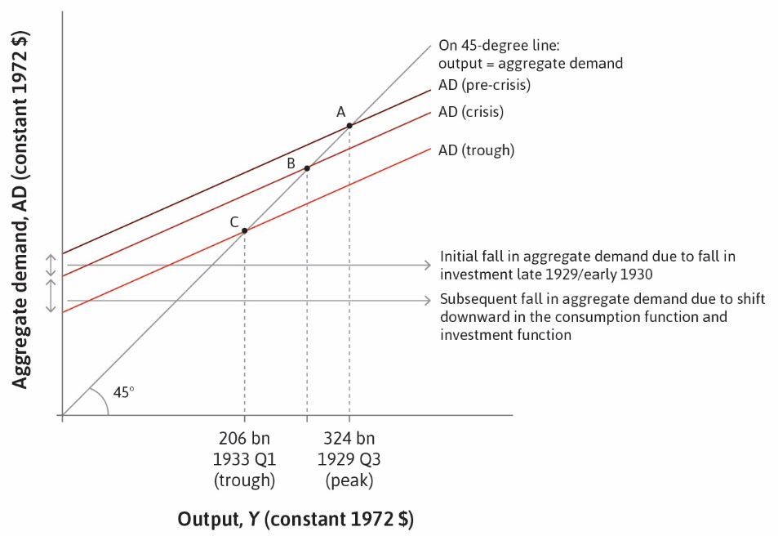

Slide 31
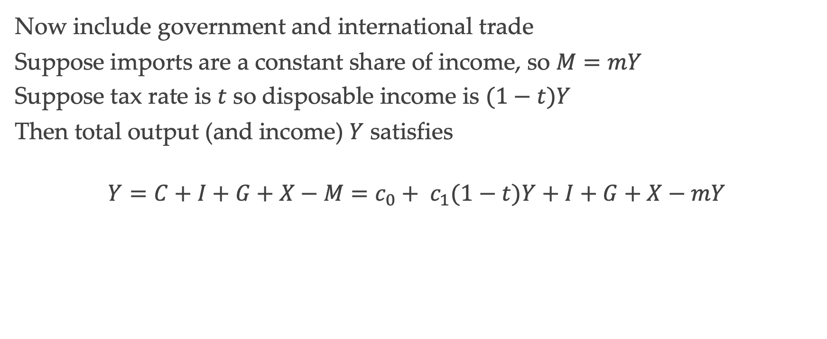
Equilibrium in the Goods Market
Now include government and international trade
Suppose imports are a constant share of income, so $M=mY$
Suppose tax rate is $t$ so disposable income is $(1−t)Y$
Then total output (and income) $Y$ satisfies
$$Y=C+I+G+X−M=c_{0}+ c_{1}(1−t)Y+I+G+X−mY$$

Slide 32
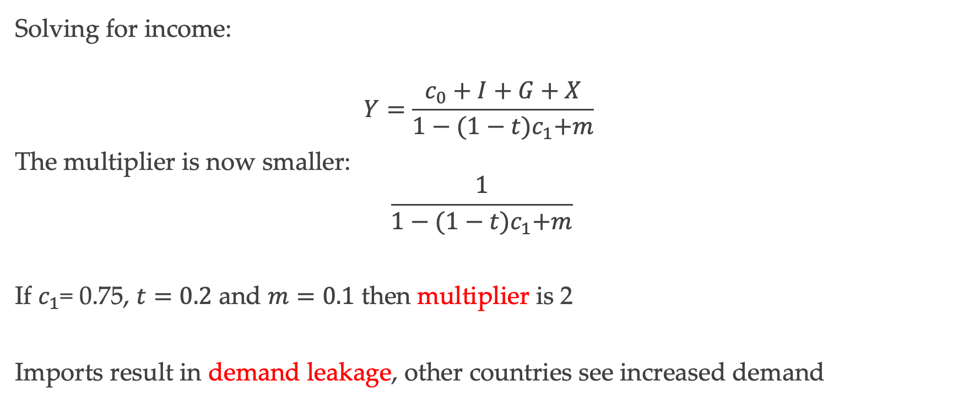
The Multiplier
Solving for income:
$$Y=\frac{c_{0}+I+G+X}{1−{(1−t)c}_{1}+m}$$
The multiplier is now smaller:
$$\frac{1}{1−{(1−t)c}_{1}+m}$$
If $c_{1}$= 0.75, $t=0.2$ and $m=0.1$ then multiplier is 2
Imports result in demand leakage, other countries see increased demand

Slide 33
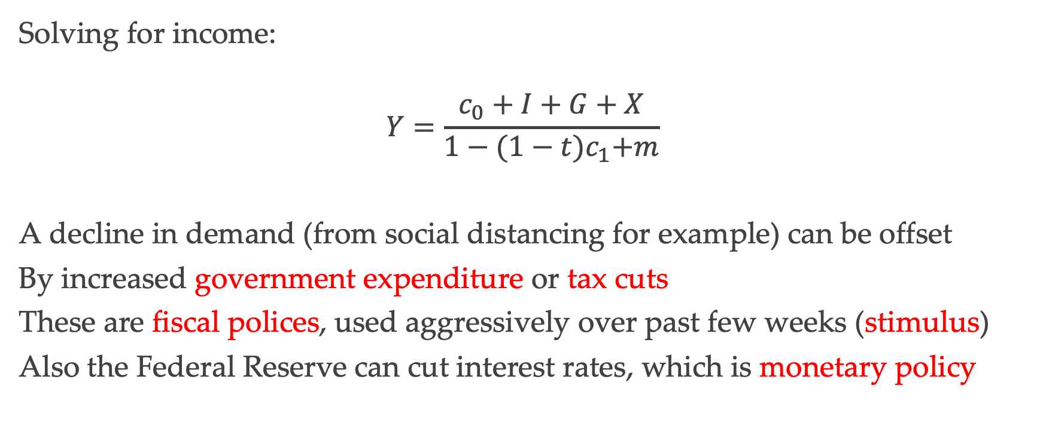
Fiscal Policy
Solving for income:
$$Y=\frac{c_{0}+I+G+X}{1−{(1−t)c}_{1}+m}$$
A decline in demand (from social distancing for example) can be offset
By increased government expenditure or tax cuts
These are fiscal polices, used aggressively over past few weeks (stimulus)
Also the Federal Reserve can cut interest rates, which is monetary policy

Slide 34
Investment and Interest Rates

Slide 35
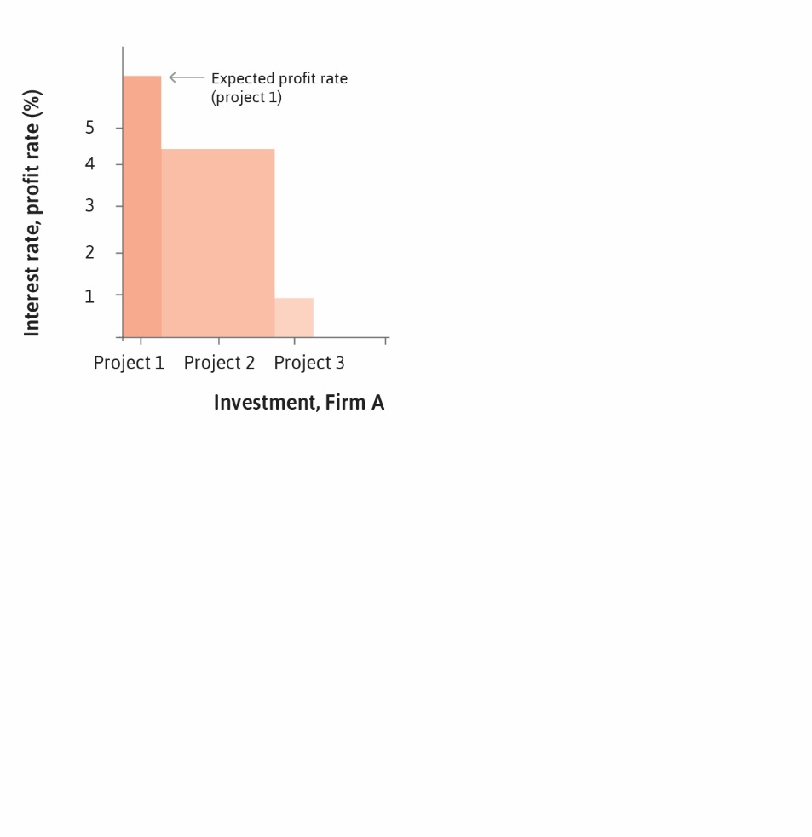

Slide 36
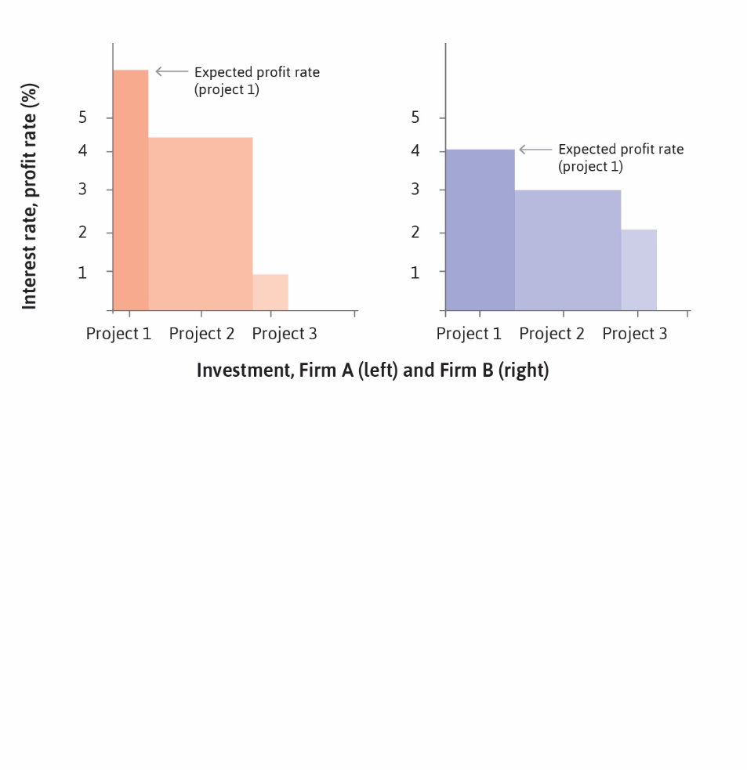

Slide 37


Slide 38
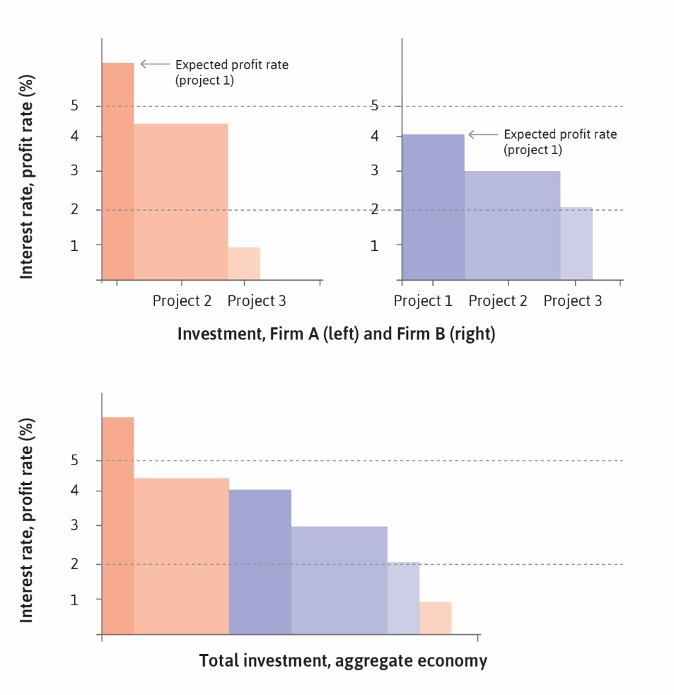

Slide 39


Slide 40
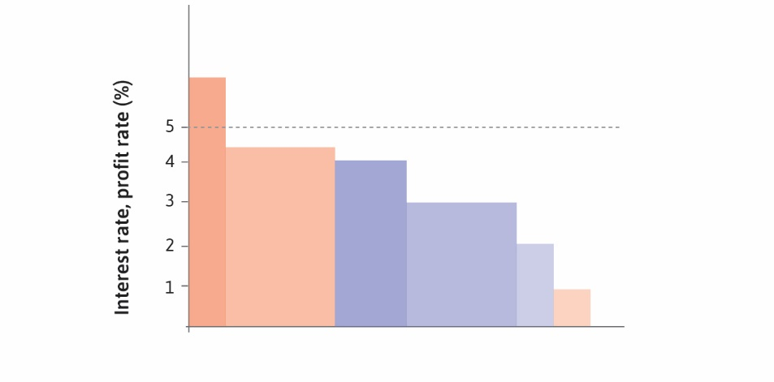

Slide 41
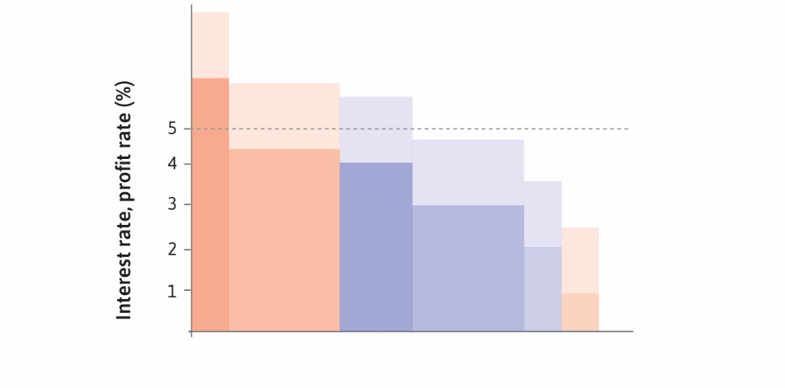

Slide 42
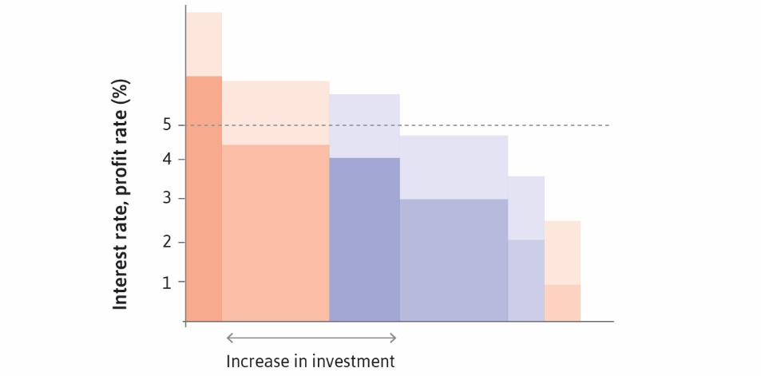

Slide 43
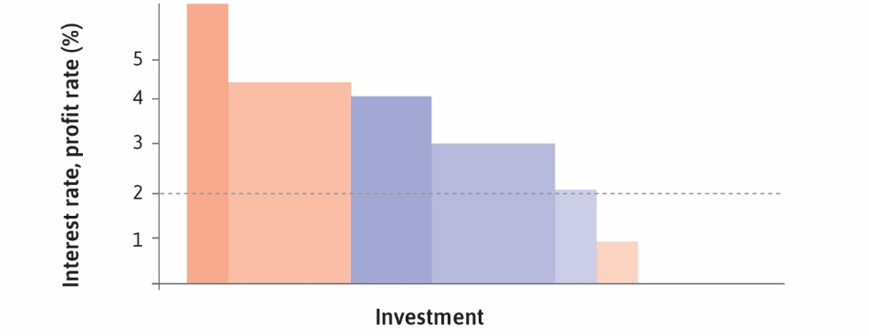

Slide 44
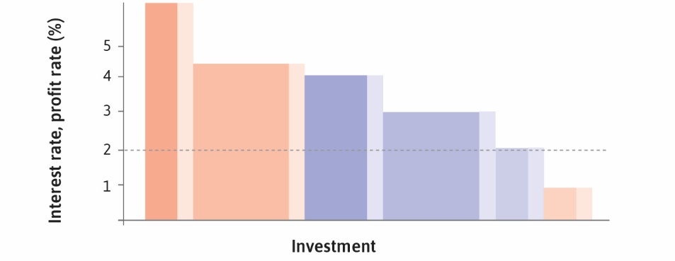

Slide 45
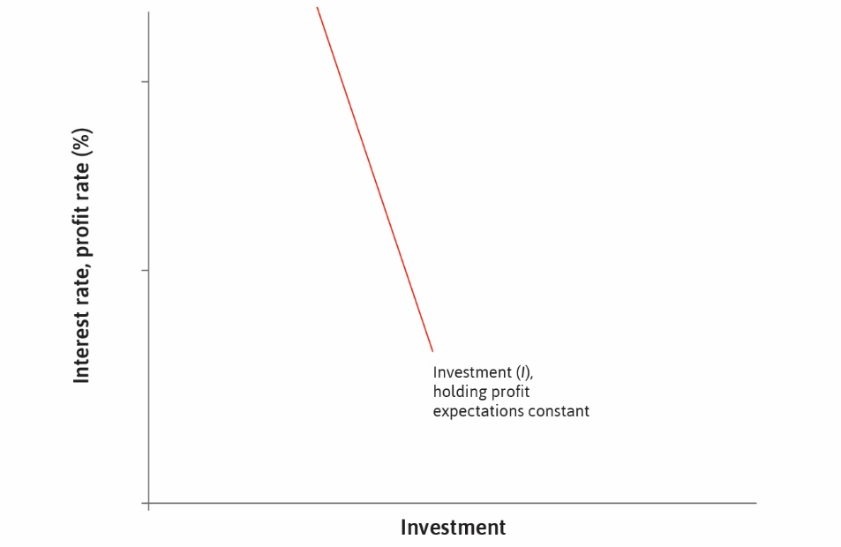

Slide 46


Slide 47
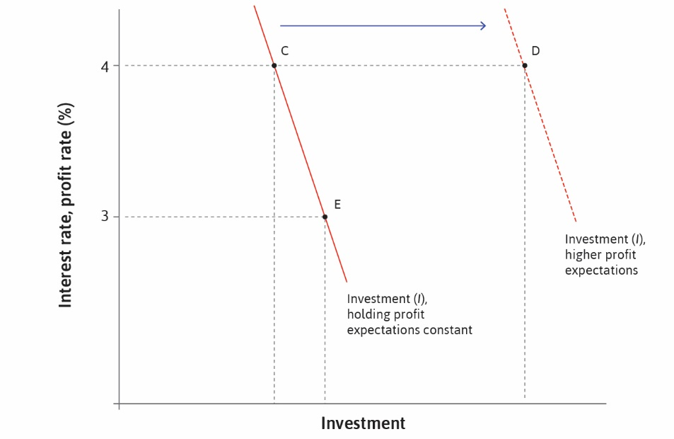

Slide 48
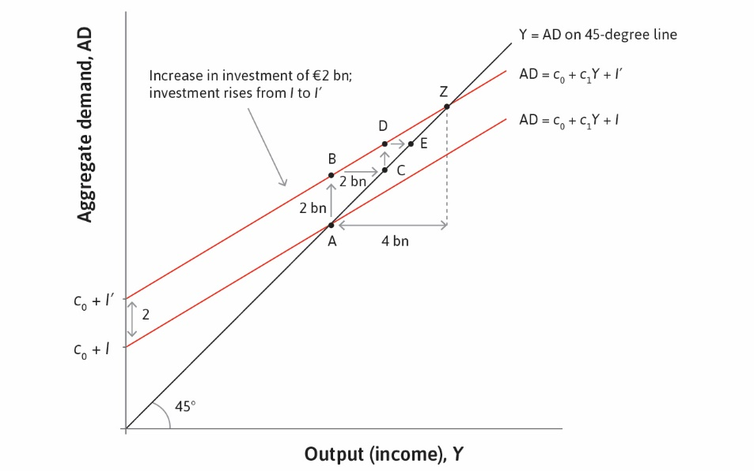

Slide 49
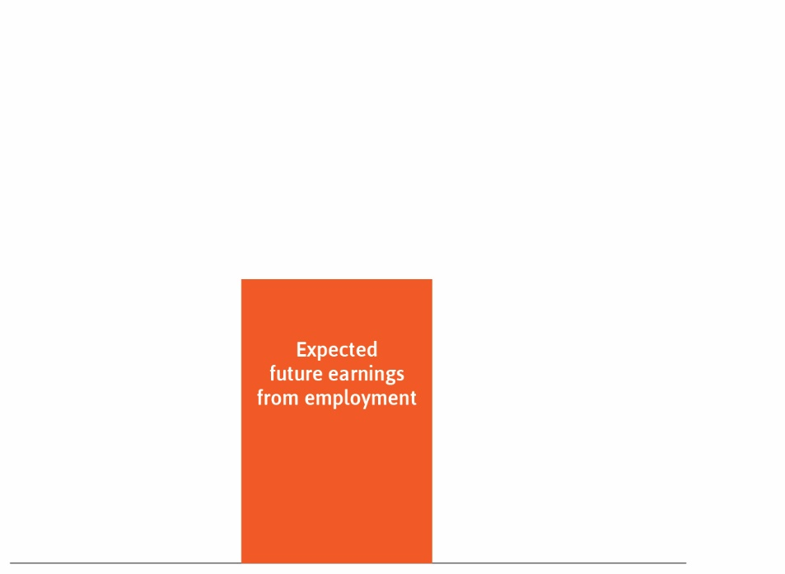

Slide 50
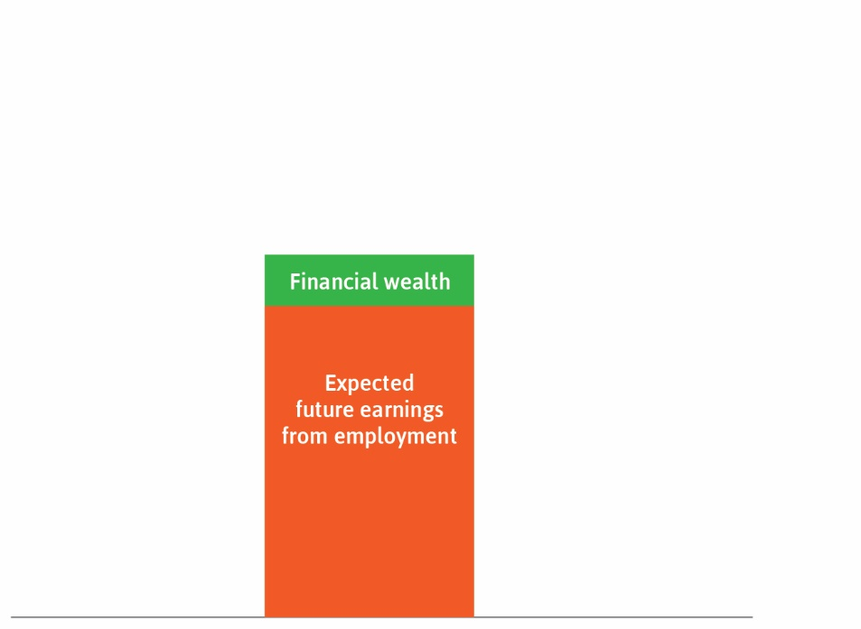

Slide 51
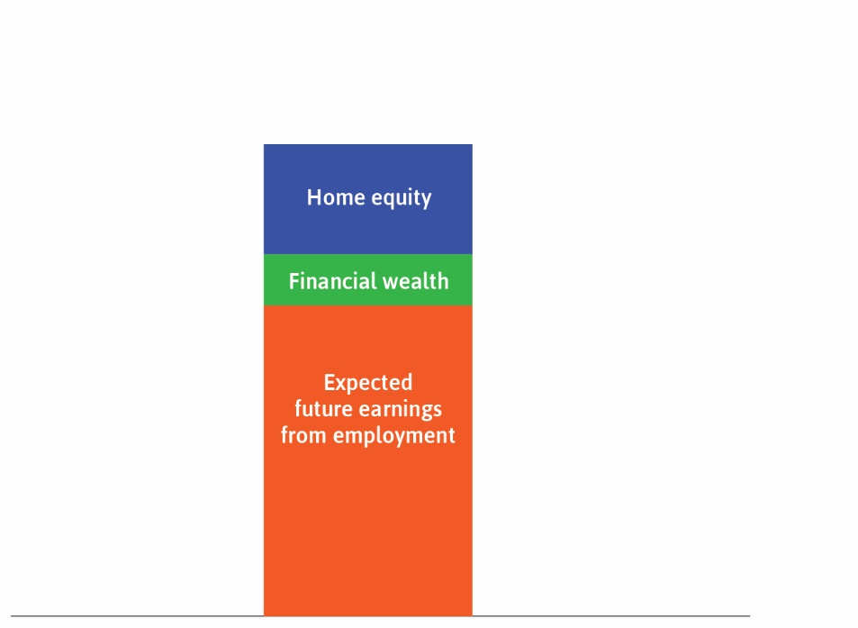

Slide 52
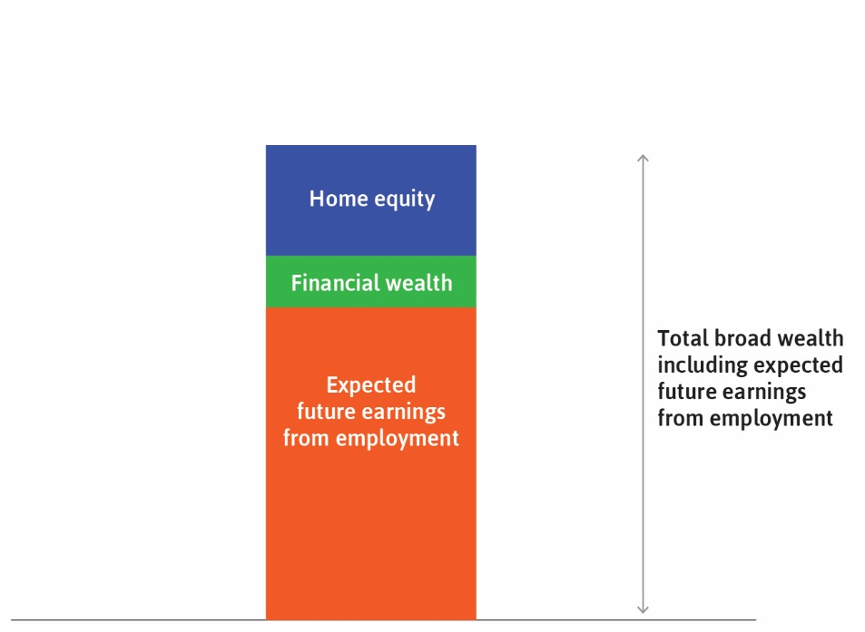

Slide 53
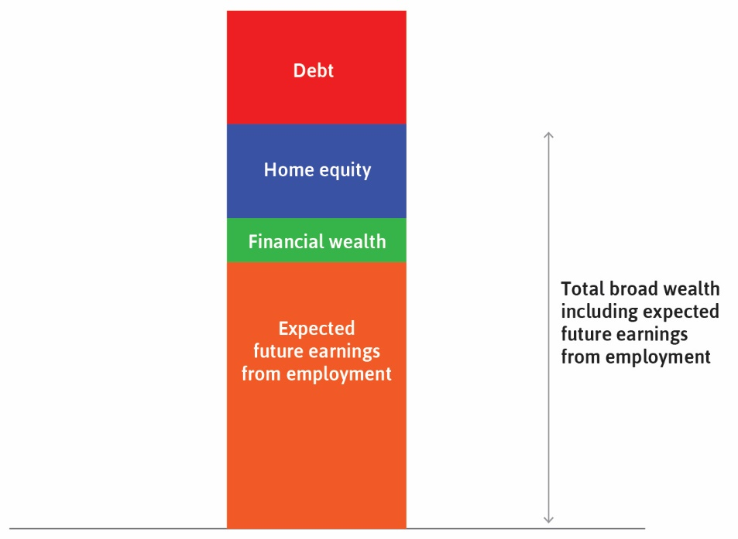

Slide 54


Slide 55
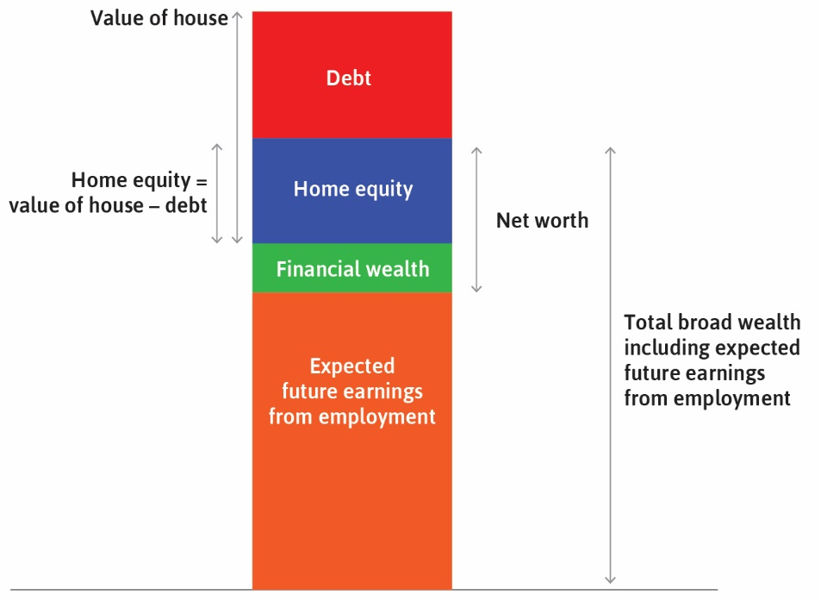

Slide 56


Slide 57
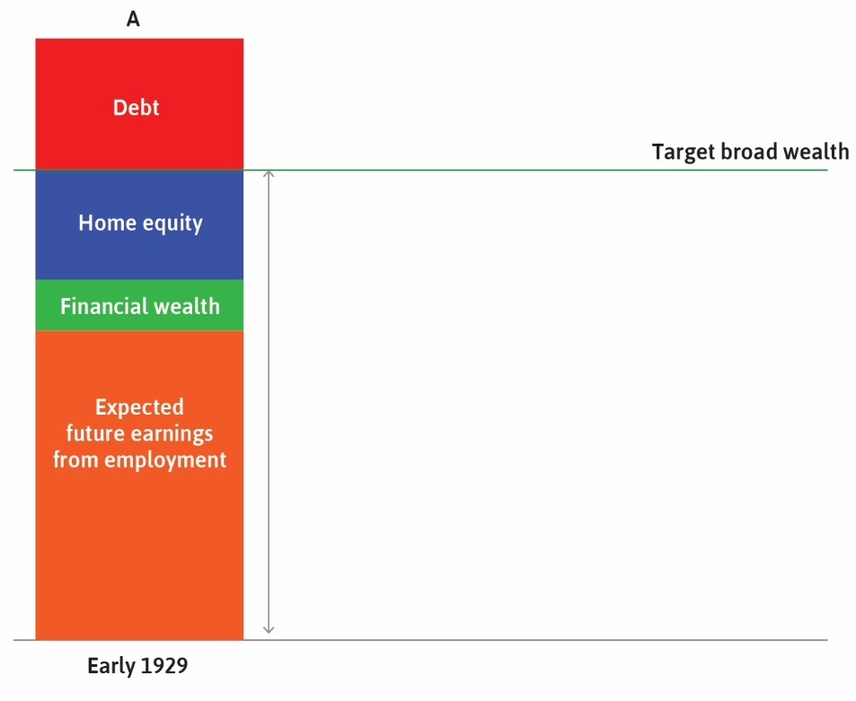

Slide 58
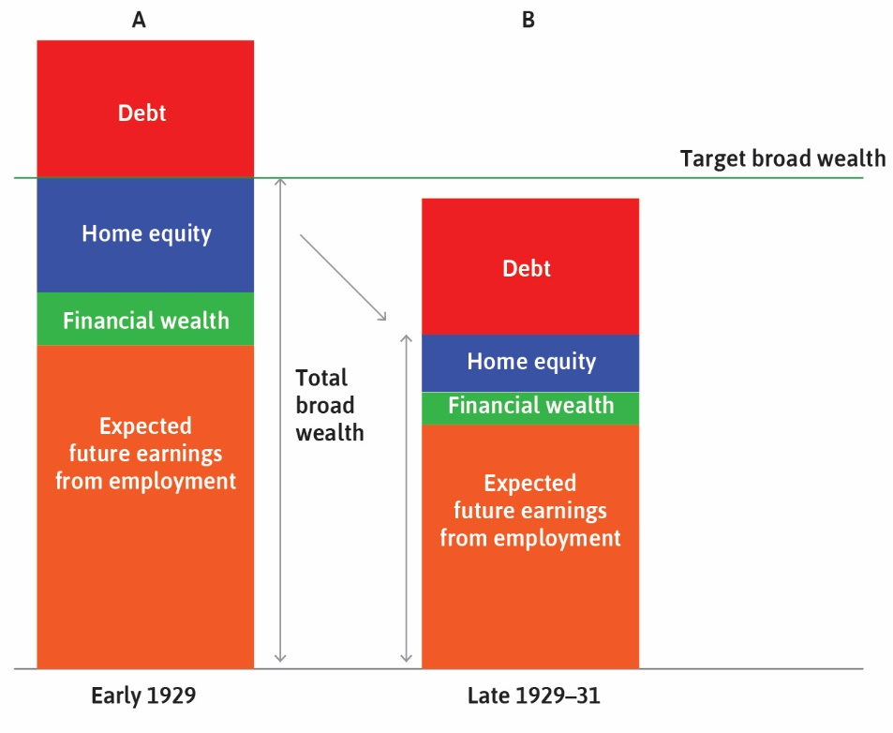

Slide 59
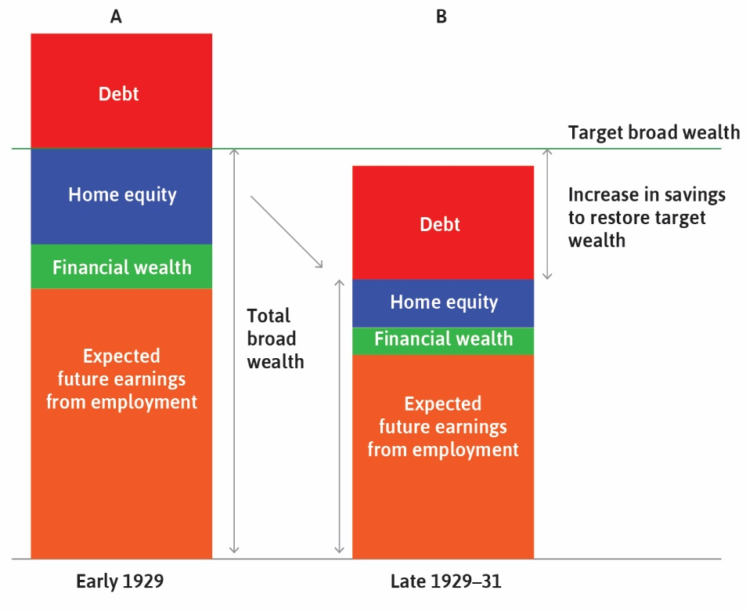

Slide 60
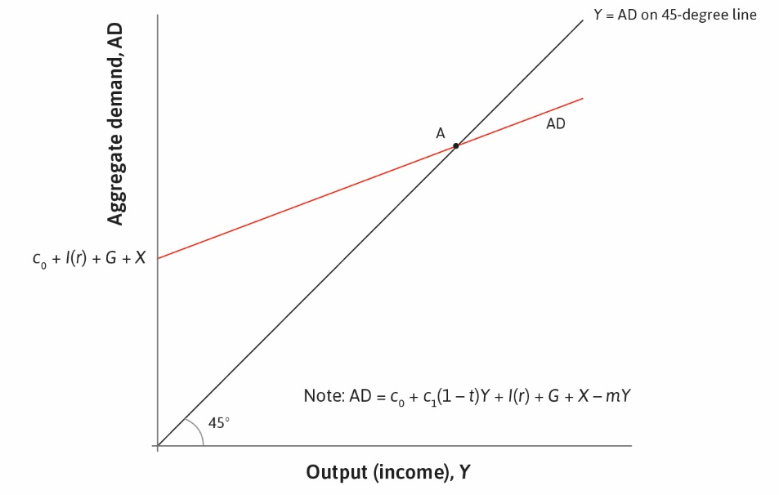

Slide 61
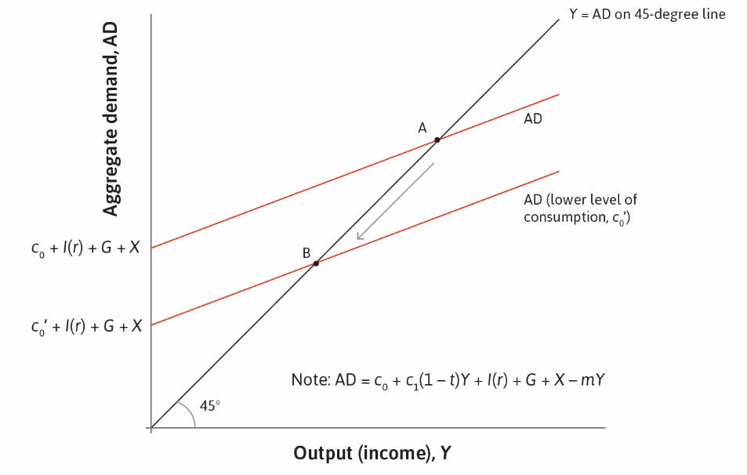

Slide 62
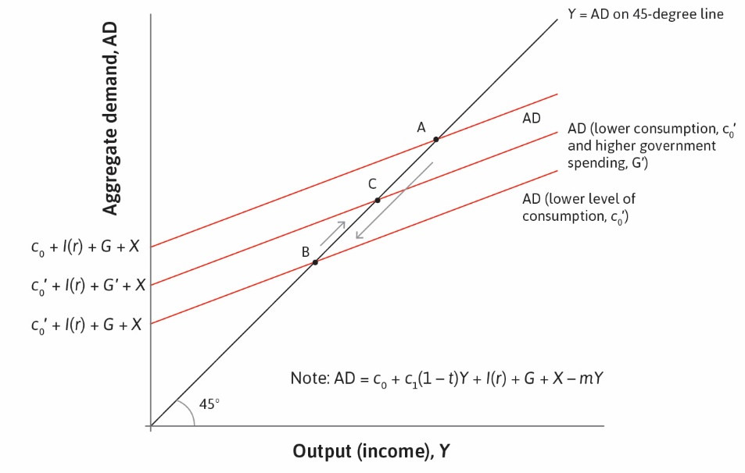

Slide 63
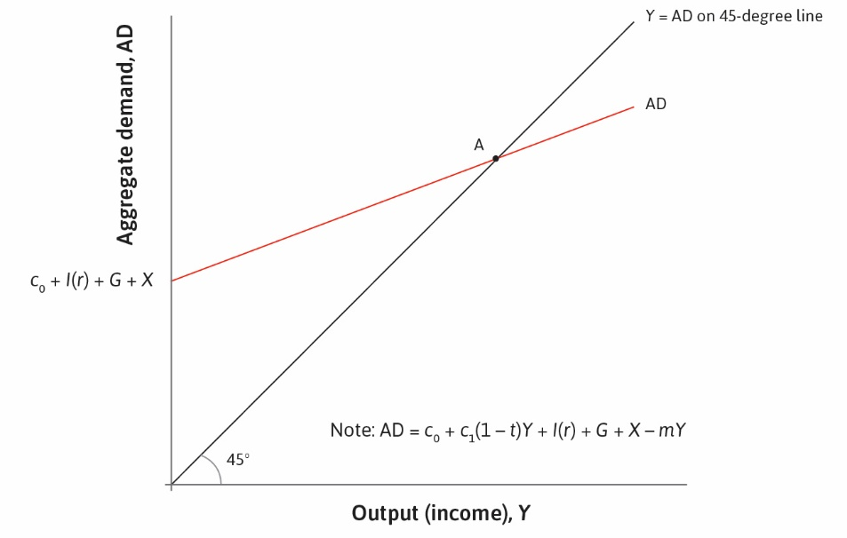

Slide 64
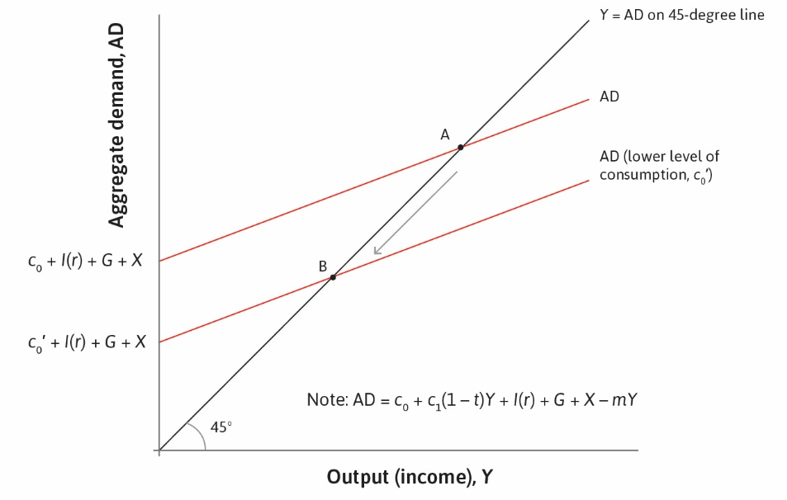

Slide 65


